Slide 1
Total Employees in Maine Counties
Companies Headquartered by County With 50+ Employees
75
22
46
164
28
29
57
144
39
60
117
43
65
568
42
182
Number of Companies
100
200
300
400
500

Slide 2
Companies with 50-200 Employees
Companies with 50-200 Employees
60
17
35
119
23
22
45
104
33
48
89
37
52
428
34
148
Number of Companies
100
200
300
400

Slide 3
Companies with 201-500 Employees
Companies with 201-500 Employees
13
4
7
26
2
7
6
30
5
9
18
3
10
100
7
25
Number of Companies
25
50
75
100

Slide 4
Companies with 501-1000 Employees
Companies with 501-1000 Employees
2
1
2
14
2
0
2
8
1
0
8
2
2
27
0
7
Number of Companies
0
5
10
15
20
25

Slide 5
Companies with 1001-3000 Employees
Companies with 1001-3000 Employees
0
0
1
4
0
0
2
1
0
3
2
1
1
8
0
2
Number of Companies
0
2
4
6
8

Slide 6
Companies with 3001+ Employees
Companies with 3001+ Employees
0
0
1
1
1
0
2
1
0
0
0
0
0
5
1
0
Number of Companies
0
1
2
3
4
5

Slide 7
Total Employees in Maine Counties
Total Employees at Companies with 50+ Employees
13,550
4,275
14,325
42,475
8,548
5,200
16,525
31,500
6,625
15,150
27,425
9,175
13,500
124,750
13,000
36,500
Number of Employees
25,000
100,000

Slide 8
Employees in Companies with 50-200 Employees
Employees in Smaller Companies with 50-200 Employees
7,500
2,125
4,375
14,875
2,875
2,750
5,625
13,000
4,125
6,000
11,125
6,500
53,500
4,250
4,625
18,500
Number of Employees
10,000
20,000
30,000
40,000
50,000

Slide 9
Employees in Companies with 201-500 Employees
Employees in Medium-Sized Companies with 201-500 Employees
4,550
1,400
2,450
9,100
700
2,450
2,100
10,500
1,750
3,150
6,300
3,500
35,000
2,450
1,050
8,750
Number of Employees
10,000
20,000
30,000

Slide 10
Employees in Companies with 501-1000 Employees
Employees in Medium-Large Companies with 501-1000 Employees
1,500
750
1,500
10,500
1,500
0
1,500
6,000
750
0
6,000
1,500
20,250
0
1,500
5,250
Number of Employees
0
5,000
10,000
15,000
20,000

Slide 11
Employees in Companies with 1001-3000 Employees
Employees in Large Companies with 1001-3000 Employees
0
0
2,000
8,000
0
0
4,000
2,000
0
6,000
4,000
2,000
16,000
0
2,000
4,000
Number of Employees
0
4,000
8,000
12,000
16,000

Slide 12
Employees in Companies with 3001+ Employees
Employees in Very Large Companies with 3001+ Employees (Excluding Health Systems)
0
0
4,000
0
3,473
0
3,300
0
0
0
0
0
0
0
6,300
0
Number of Employees
0
2,000
4,000
6,000

Slide 13
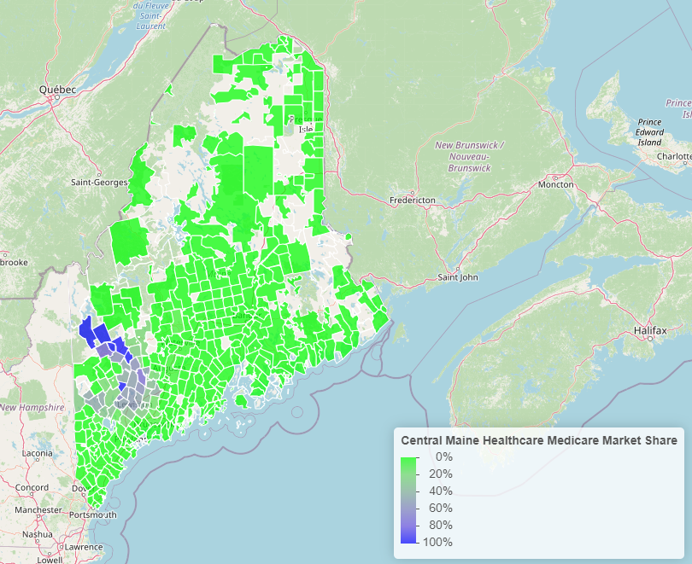
Central Maine Market Share

Slide 14
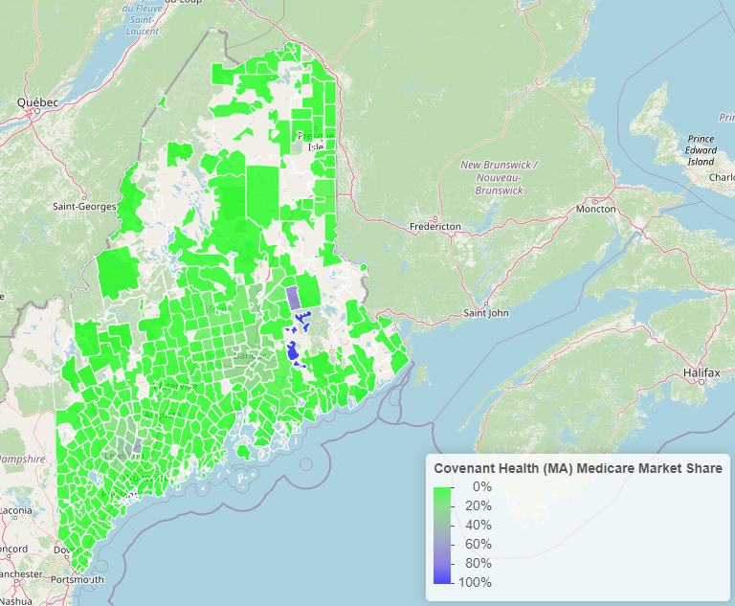
Covenant Health Market Share

Slide 15
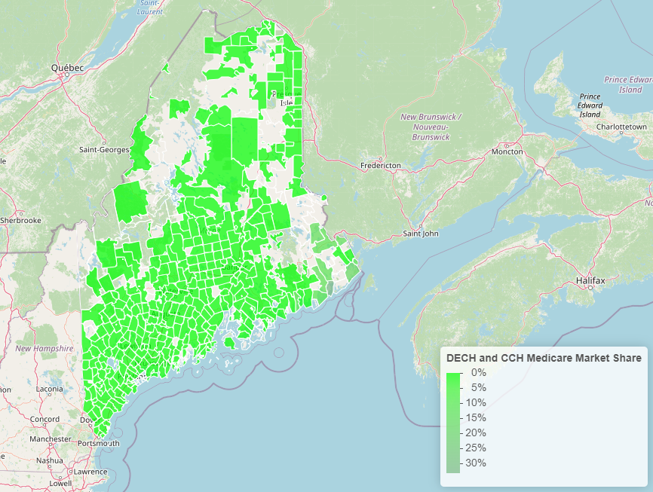
DECH and CCH Market Share

Slide 16
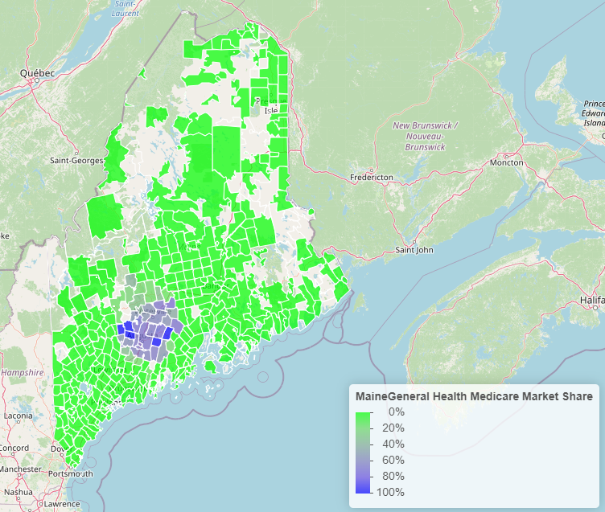
Maine General Market Share

Slide 17
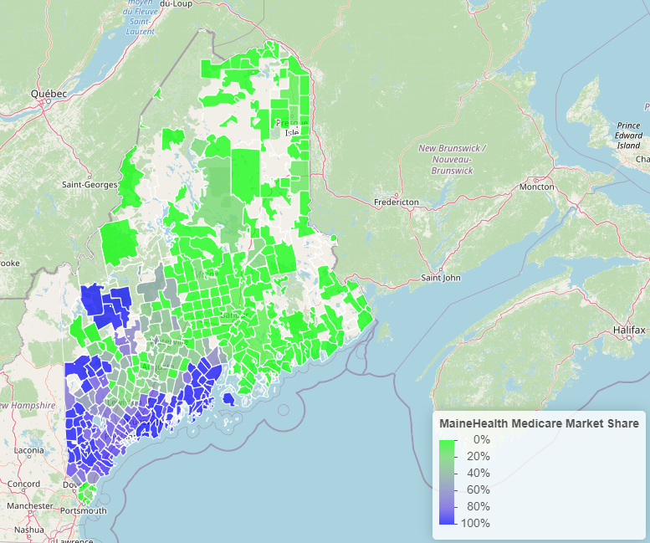
MaineHealth Market Share

Slide 18
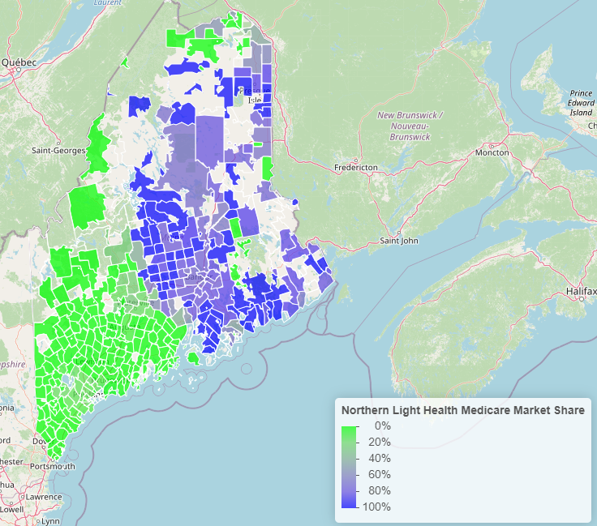
Northern Light Market Share

Slide 19
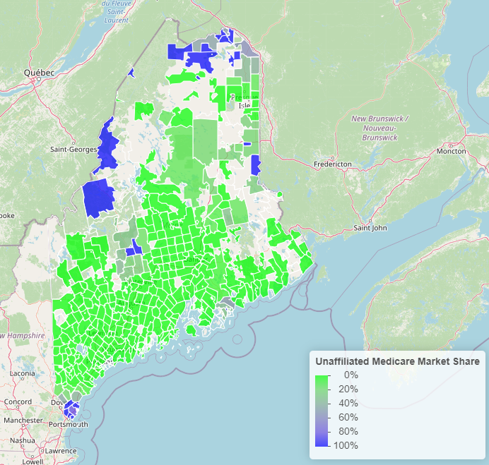
Unaffiliated Health Systems Market Share

